Slide 1
1920s Diseases
Measles, Scarlet Fever, and Staph

Slide 2
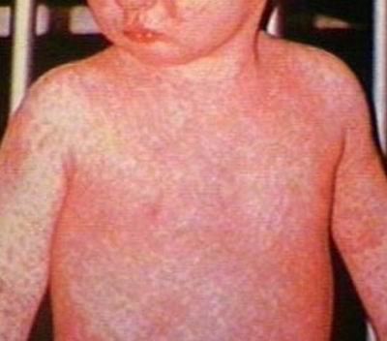
Measles
Measles, a childhood disease characterized by high fever, sore throat, and skin rash, was widespread in the 1920s. Lasts up to 4 weeks, permanently scars body, and less than a 50% chance of viable pregnancy.

Slide 3
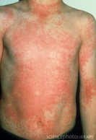
Scarlet Fever-Strep
Scarlet fever is a disease caused by infection with the group A Streptococcus bacteria (the same bacteria that causes strep throat.
The rash usually first appears on the neck and chest, then spreads over the body. It is described as "sandpapery" in feel.
Often leaves hearing impairment, chronic pneumonia, meningitis (inflammation of spinal cord), & paralysis.

Slide 4
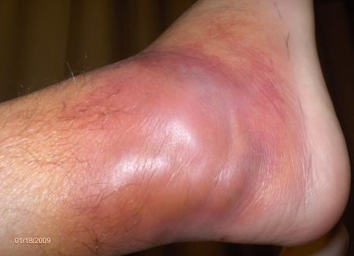
Staph
A staph infection is caused by a Staphylococcus bacteria. About 25% of people normally carry staph in the nose, mouth, genitals, or anal area. The foot is also very prone to picking up bacteria from the floor. The infection often begins with a little cut, which gets infected with bacteria.
Long term hospital stays, life-threatening infections, large gaping wounds, blood poisoning, which can lead to sepsis. Resistant to regular antibiotics such as Penicillin and Amoxicilin.

Slide 5
Journal
All three of these diseases survived the Roaring 20s, WW1, The Great Depression, WW2, Vietnam, and more. They are not going away.
Rank the diseases from 1-3 (1 being, I want you first and 3 being, I want you last) and tell me your reasoning behind each disease and it’s rank.

